Slide 1
Bluetooth® Technology Introduction
MAY 2017

Slide 2
Topics
Physical Layer
Link Layer
Application Layer (GATT)
Security (SMP)
  Frequency Allocation
  Timing
  Throughput
  Bluetooth Topologies
  Device Discovery
  Connection process
  The GATT Database
  Service Discovery
  Transferring Data
  Pairing & Bonding
  Privacy
  Encryption
Notes:
To understand Bluetooth technology, we will speak about 4 main topics:
How the data is transmitted physically. Frequencies, modulation, timing.
How connection is made between two devices. Device discovery, connection, packets
How data is exchanged on the application level
How data exchange is secured

Slide 3
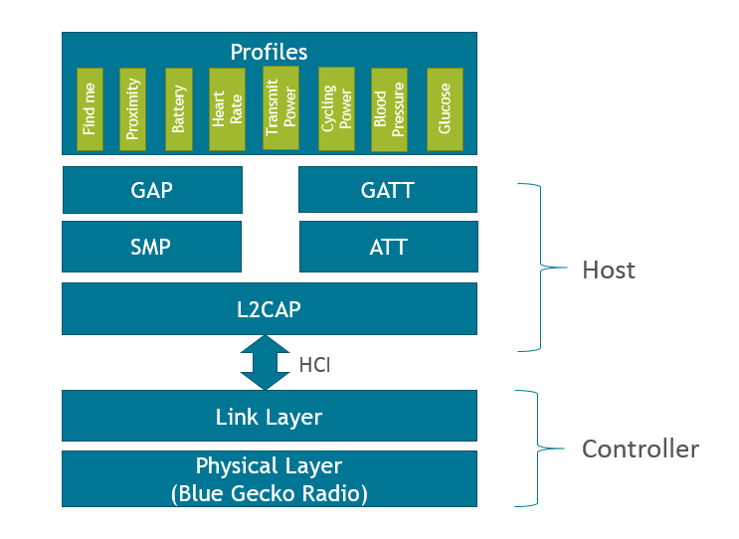
BLE Layered Architecture
Notes:
Just like TCP/IP stack, the Bluetooth stack consist of layers
-the physical layer is responsible for transmitting the data over the air.
-the link layer organizes data into packets and controls the connection process: device discovery, connection establishment
-the L2CAP layer is responsibe for higher level protocol multiplexing and for packet segmentation and reassembly
-the SMP layer is responsible for the secure connection. Exchanging keys, etc.
-the ATT layer is responsible for sending data over the link. Reading and writing any attributes.
-the GATT defines services, characteristics and descriptors, all of which is an attribute handled by the ATT. GATT is responsible for discovering the structure of services and characteristics
-the GAP defines the generic procedures related to discovery of Bluetooth. It is related to all layers
-the lower and higher layers can be handled separately by a Host and a Controller. The interface between these two is the so called Host Controller Interface (HCI) which is also defined by the Bluetooth standard. If the Host and the Controller is implemented by two different vendor, they can still communicate via this standard interface.

Slide 4
Physical layer
Profiles
GAP
GATT
SMP
ATT
L2CAP
Link Layer
Physical Layer

Slide 5
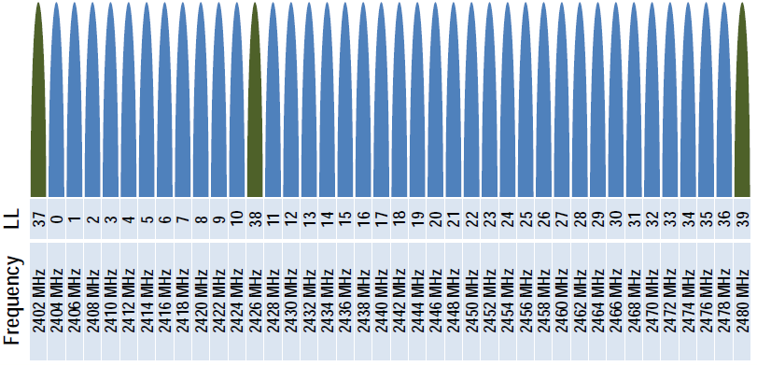
Frequency Allocation
2.4GHz ISM Band
  License free in most countries
40 channels
  3 advertisement channels
  37 data channels
  2 MHz wide each
GFSK modulation
Uses Adaptive Frequency Hopping (AFH)
  Reliable
  Robust
  Adapts to interference
Notes:
The Bluetooth protocol uses 40 channels in the 2.4GHz frequency range. Each channel is 2MHz wide.
The devices advertise on 3 of these channels to find each other. Then, when a connection is established, the two devices participating in the connection agree on a pseudorandom sequence. They will hop through the 37 data channels in this order. The frequency hopping happens always at the end of the connection interval, see later.
The modulation used is Gaussian Frequency Shift Keying.
Adaptive frequency hopping is not yet implemented in our stack, but the Bluetooth standard allows for defining the channels to be used. When a connection is opened, the two participiants agree on which channels they will use and which channels they won’t. Adaptive frequency hopping means, that this can change during the connection.

Slide 6
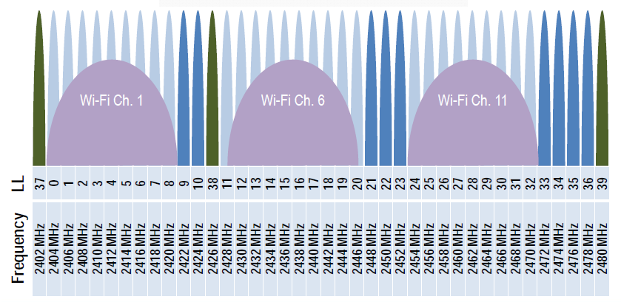
Frequency Allocation
1 Mbps bit rate
  Typical throughput <= 650 kbps
  Bluetooth 5.0 adds support for 2 Mbps
  (throughput <= 1300 kbps)
TX power up to +20 dBm
  Was limited by CE and FCC regulations
  Addendum 5 (Dec 2016) increases to +20 dBm
    Also re-introduces power class designations
Range
  0 – 500 meters
  Typically 0-50 meters to a smart phone
Notes:
The modulation rate is 1MSymbol/sec which corresponds to 1Mbps. However, due to the headers and inter frame spacings, the actual maximum datarate is around 650kbps
Bluetooth 5 enables 2MSymbol/sec datarate as an option, which can result in 1300kbps throughput.
The max. Tx power enabled by the standard is currently +20dBm, however, in most countries only 10dBm is enabled by regulatories!!
The figure shows the overlapping of the WiFi and Bluetooth channels. Strong WiFi usage in the area may cause the Bluetooth datarate to fall back due to retransmissions caused by interferences.

Slide 7
Timing
  Master sends at least one packet every connection interval (even if there is no data to send)
  Slave can send a packet as a response to the packet of the master after 150us IFS (inter-frame spacing)
  Connection interval varies from 7.5ms to 4000ms
  Data payload varies between 20 and 244 bytes / packet
  Multiple packets can be sent in one connection interval
  Slave devices can use slave latency – enables them to skip N connection intervals when there is no data to transmit
master
slave
master
slave
master
slave
master
slave
master
slave
IFS
150us
IFS
150us
IFS
150us
IFS
150us
IFS
150us
IFS
150us
IFS
150us
Connection interval
Connection interval
Slave latency = 1, 1 conn. interval is skipped
Notes:
Timing is very important in Bluetooth Low Energy. It enables the devices to go into sleep mode, while no packets are expected. I.e. there is no need for continuous background receiving!
It is precisely defined when the device has to wake up to start receiving/transmitting. A communication sequence always starts at the beginning of a connection interval, and lasts while at least one side has something to send.
When the device has no more data to send, it is signalled to the other side, and both devices can go to sleep until the next connection interval.
It is always the master that starts the sequence, and it always has to send at least one empty packet. The slave has to respond at least every (N+1)th connection interval, where N is the slave latency.
The master/slave roles are decided when the connection is made.

Slide 8
Throughput
  Main factors affecting throughput are
    Connection interval
    Bitrate (1 Mbps / 2 Mbps)
    MTU size (Maximum Transfer Unit size / GATT operation)
    PDU size (Protocol Data Unit size / packet)
    The used ATT protocol operation – ACKnowledged vs. UnACKnowledged
      Acknowledged operations must be ACKed, before new one can be sent (one acknowledged operation can be made per conn. interval)
      One or multiple unacknoledged operations can be made in a single connection interval
  Examples:
    Connection interval of 20ms
    1Mbps
    21B packet x 1 packet / connection interval
    ACKnowledged ATT operation : read, write, indicate
    1000ms/(20ms * 2) * 21B = 525 B/sec (4,200 bps)
    Connection interval of 12.5ms
    2Mbps
    244B packet x 8 packets / connection interval
    Unacknowledged ATT operation : write no response, notify
    1000ms/(12.5ms) * 244B * 8 = 156,160 B/sec (1,249,280 bps)
Notes:
The throughput of a Bluetooth channel depends on many factors. This is detailed e.g. here: https://www.silabs.com/community/wireless/bluetooth/knowledge-base.entry.html/2015/08/06/throughput_with_blue-Wybp

Slide 9
Link layer
Profiles
GAP
GATT
SMP
ATT
L2CAP
Link Layer
Physical Layer

Slide 10
Link Layer Roles
MASTER
SLAVE
Master
Slave
Sends packets first in each connection interval
Sends packets as a response to the packets of the master
Notes:
Each connection has a master and a slave. But this is not to be confused with the server and client roles, which is defined in higher layers.
The master is who sends the packet first in a connection interval, but this is not necessarily the central device.

Slide 11
Bluetooth Topologies
Connectionless
    Advertiser only sends out advertisements i.e.
    broadcast data
    Advertiser can allow or disallow connections
    Scanner only listens for advertisements
    Scanner can connect to an advertiser if enabled
Point-to-point
    Slave can connect to one master (BT 4.0)
Point-to-multiple point
    Slave can connect to multiple masters (BT 4.1)
    Master can connect to one or multiple slaves
    Each connection is handled separately
    One device can act as a master and a slave at the same time
  Mesh
    More devices connected together (new standard)
Beacon
Point to Point
Star (up to 8)
LE dual topology
Bluetooth Mesh
Notes:
Bluetooth is basically a connection oriented protocol, but the advertisement packets can also be used to broadcast data. This is e.g. used for beaconing.
One device can connect to multiple devices, and it can fulfil the master role in one connection while being in a slave role in another connection.
Bluetooth Mesh is a new Standard. It is more than a topology. Bluetooth mesh defines the packet formats and layers sent through the Bluetooth Mesh network, so it is fundamentally different than the Bluetooth standard. It just uses Bluetooth advertisements and connections as bearers of Bluetooth mesh packets.

Slide 12
Packet format for all PDUs
Preamble
  Freq synchronization / timing estimation
  10101010/01010101
Access Address
  Instead of physical addresses - correlation code
  Different for all connections
  Adv Channel: AA=0x8E89BED6
PDU
  Advertising Channel PDU (AA=0x8E89BED6)
  Data Channel PDU
CRC
  24 bit Cyclic Redundancy Check for reliable data transmission
LSB
MSB
Preamble (1B) | Access Address (4B) | PDU (2..257B) | CRC (3B)
Notes:
The link layer defines the format of the packet.
The most interesting part of the packet is the Access Address. After a connection is created between two devices, they won’t use their Bluetooth address to address the other device any more, but they agree on an Access Address. This address identifies the connection and the two device can filter for these packets.

Slide 13
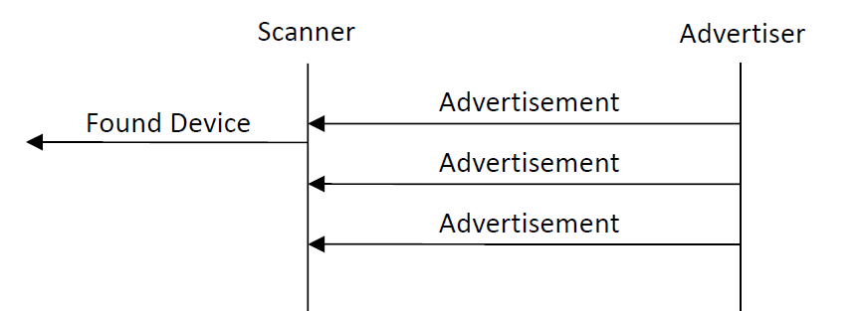
Device Discovery
Device advertisement
  Devices advertise themselves
  They broadcast advertisement packets on
  one, two or three ADV channels
  Scanners listen for advertisements to discover devices
Data broadcast
  Advertisement can carry upto 31B of data
  Typically device name, TX power, supported services
  Can also be vendor specific data
Benefits of advertisements
  Low power – Radio is active <1ms during advertisement (non-connectable mode)
  Quick – ADV operation takes just 1.3 ms (non-connectable mode)
  Flexible - ADV interval ranges from 20ms to 10.2s
Notes:
In order to create a connection two devices have to find each other first. This is solved by advertisement. At least one device has to send advertisement packets on the advertisement channels. The other side listens to these advertisements, choose the device it wants to connect to, and initiates a connection.
Advertisement is not only important to make it possible for the two devices to find each other. It is also needed to initiate a connection. Connection requests can be sent to a device only right after the advertisement.
This means, that 2 devices cannot connect without advertisement, even if they know each others Bluetooth address!
Advertisements can also be non-connectable, which is typically used for beaconing.
Advertisements can carry different data, like the name of the device, the services it supports, custom data, etc.

Slide 14
Device Discovery
Advertisement types
  Non-connectable
    Only advertisement data is sent out
  Scannable non-connectable
    Scanner can send SCAN_REQ
    Advertiser responds with SCAN_RSP, which extends the advertisement with additional 31 bytes
  Undirected connectable
    Scanner can send SCAN_REQ and CONNECT_REQ
  Directed connectable
    Scanner can send CONNECT_REQ
    Only the addressed device can connect
Scanning
ADV_IND
ADV_IND
SCAN_REQ
SCAN_RSP
ADV_IND
T_{IFS}
_{150 us}
T_{IFS}
T_{IFS}
<10 ms
(high duty <3,75 ms)
Start of Adv
Event
Adv Ch = 37
<10 ms
(high duty <3,75 ms)
End of Adv
Event
Ch = 38
Ch = 39
Connecting
ADV_IND
CONNECT_REQ
Transmit window
(1.25 ms – 10s/CI-1.25 ms)
M->S
S->M
M->S
S->M
M->S
T_{IFS}
_{150 us}
1.25
ms
Transmit
window
Offset
_{(0-connInt)}
T_{IFS}
_{150 us}
T_{IFS}
_{150 us}
T_{IFS}
_{150 us}
Connection interval
7.5ms-4s
Connection interval
7.5ms-4s
Notes:
Non-connectable mode: advertisement periodically sent out to broadcast data, or simply to show the presence of the device. It is mostly used for beaconing.
Scannable non-connectable mode: the device sends out an advertisement, then listens for scan request from other devices. If a scan request is received, a scan response is sent to the specific device to provide more data
Undirected connectable mode: the device sends out an advertisement, then listens for scan requests and connection requests from other devices. Upon receiving a connection request, a connection procedure is initiated
Directed connectable mode: the device sends out an advertisement, then listens for connection requests. The connection request is accepted only from the addressed device.

Slide 15
Device Discovery
Advertisement Channel PDU
  PDU type
    ADV_IND / ADV_DIRECT_IND / ADV_NONCONN_IND / ADV_SCAN_IND
    SCAN_REQ / SCAN_RSP / CONNECT_REQ
  TxAdd – interpretation of TX Address (0: Public, 1:Random)
  RxAdd - interpretation of RX Address (0: Public, 1:Random)
Adv channel PDU
Header (2B) | Payload (0..37B)
PDU type (4b) | RFU (2b) | TxAdd (1b) | RxAdd (1b) | length (6b) | RFU (2b)
AdvA (6B) | AdvData (0..31B)
InitA (6B) | AdvA (6B) | LLData (22B)
Notes:
If the access address of a packet is 0x8E89BED6, it means, that the packet contains advertisement and the PDU has to be parsed as an Advertisement Channel PDU
Public address is the static address of the device
Random address means a temporary address that is intended to hide the identity of the device

Slide 16
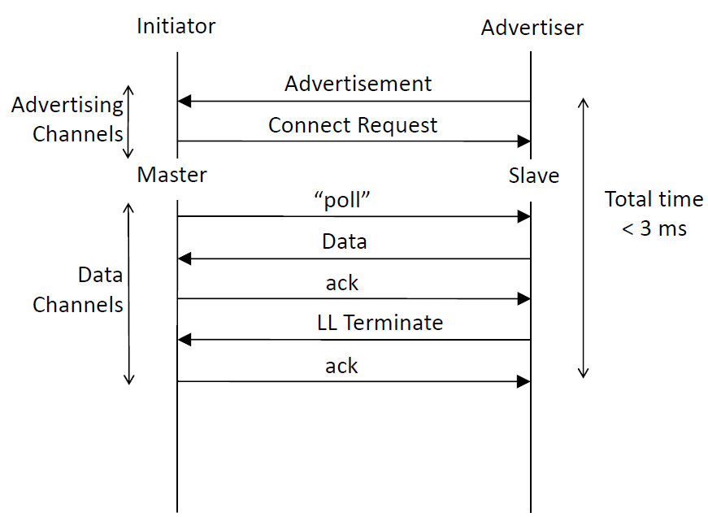
Connection
Connection process
  Advertiser sends advertisements
  Scanner sends connection request
  Scanner becomes master, advertiser becomes slave
  Both side can poll data from the other side
  Data is sent in the next conn. interval
  ACK can be sent in the next conn. Interval
Connections
  Enable reliable data transfer
  Connections use ACKs, re-transmits, 24-bit CRC to ensure correct data delivery
  Connections enable the use of encryption and protection of data confidentiality
Notes:
Device can connect to another device by sending a connection request after the advertisement was received. A time window is defined after the advertisement packet within that connection requests are accepted.
It is not possible to connect to another device without advertisement, even if we know the Bluetooth address of the other devices. I.e. the advertisement is not only for dicovery purposes, but also to make connection establishment possible!
Once 2 devices are connected, they can communicate until the connection is closed. During the connection the devices are not addressed with their Bluetooth address, but every connection has a unique access address, which is exchanged during connection establishment. This access address is sent at the beginning of each packet.
Once a connection is closed, the access address is not valid any more and a new connection has to be established, i.e. advertising has to be restarted.

Slide 17
Data transfer
Data Channel PDU
  LLID
    01 LL Data (Empty / Continuation of L2CAP fragment)
    10 LL Data (Start of L2CAP fragment)
    11 LL Control PDU – Allows Link Layer procedures
  NESN/SN
    Flow control
  MD
    More Data
  Payload
    Carries L2CAP fragments
    L2CAP packets discussed later
Data channel PDU
LL Header (2B) | Payload (0..251B) | MIC (4B)
LLID (2b) | NESN (1b) | SN (1b) | MD (1b) | RFU (3b) | length (8b)
Notes:
Bluetooth data is sent in packets. If the data packets of higher layers are too long and they do not fit into one Link Layer packet, then they get segmented into fragments to fit in one packet. The Link Layer signals which part of the segment is sent.
MD – more data signs that there is still data to be sent, hence the other side should listen for another packet. If there is no more data, the other side can go sleep until the beginning of the next connection interval.

Slide 18
L2CAP
Logical Link Control and Adaptation Protocol
Profiles
GAP
GATT
SMP
ATT
L2CAP
Link Layer
Physical Layer

Slide 19
L2CAP packets
  Protocol multiplexing for higher layers
  Channel based connection between 2 endpoints
  Fixed Channel ID for each endpoint
Packet Types:
  Basic Information Frame (B-Frame)
  Control Frame (C-Frame)
Modes of operation:
  Basic L2CAP Mode (B-Frames + C Frames)
  LE Credit Based Flow Control Mode (C-Frames)
ATT
CID = 0x04
SMP
CID = 0x06
L2CAP
L2CAP Signaling
CID = 0x05
Link Layer
B-Frames
Length (2B) | Channel ID (2B) | Payload (0..65535 B)
C-Frames
Length (2) | Channel ID =0x0005 | Code (1) | ID (1) | Length (1) | Data
Notes:
L2CAP is the bridge between lower and higher layers. It defines the higher protocol. If data had to be segmented, the L2CAP layer is responsible for reassembly.

Slide 20
Application Layer
GATT – General Attribute Protocol
Profiles
GAP
GATT
SMP
ATT
L2CAP
Link Layer
Physical Layer

Slide 21
Application Layer Roles
ClienT
SERVER
GATT client
GATT server
reads / writes data in the remote GATT database
Stores data in the GATT database
Notes:
In the application layer we define a client and a server. This is independent of the master-slave roles.
The client queries data from the server or writes data to the server. The server can also send notifications to a client (with data), but it cannot read any data from the client or write any data to the client.
A device can be a server and a client at the same time. So it can read/write the database of the remote device, while it maintains an own database that can be read/written by the remote device.
The most common usecase is that we use a smartphone as a client and a sensor/actuator device as a server. So we can e.g. query the temperature from a temperature sensor and display it on the smartphone.

Slide 22





Transferring data (ATT)
The Attribute Protocol (ATT) is the only data transfer protocol in BLE
  Uses Client – Server architecture
    Server stores the data
    Client reads/writes data from/to the server
    Server can also push data to the client in notifications
  Data is stored in attributes
    From 0 up to 64kB
    Can be fixed or variable length
  Data can be accessed with the following operations
    Read - reads data upto MTU
    Read long - reads longer than MTU
    Write - writes data up to MTU
    Write without response - Just like write, but no ACK
    Indicate - server notifies the data has changed, needs ACK
    Notify - server notifies the data has changed, no ACK
Notes:
Data is stored on attributes on the server. These attributes can be read/written by the client. The server can also push data to the client if it changed.
The attribute protocol (ATT) does not define how to interpret the content of the attributes. They are just arrays of bytes that can be addressed individually by handles.

Slide 23
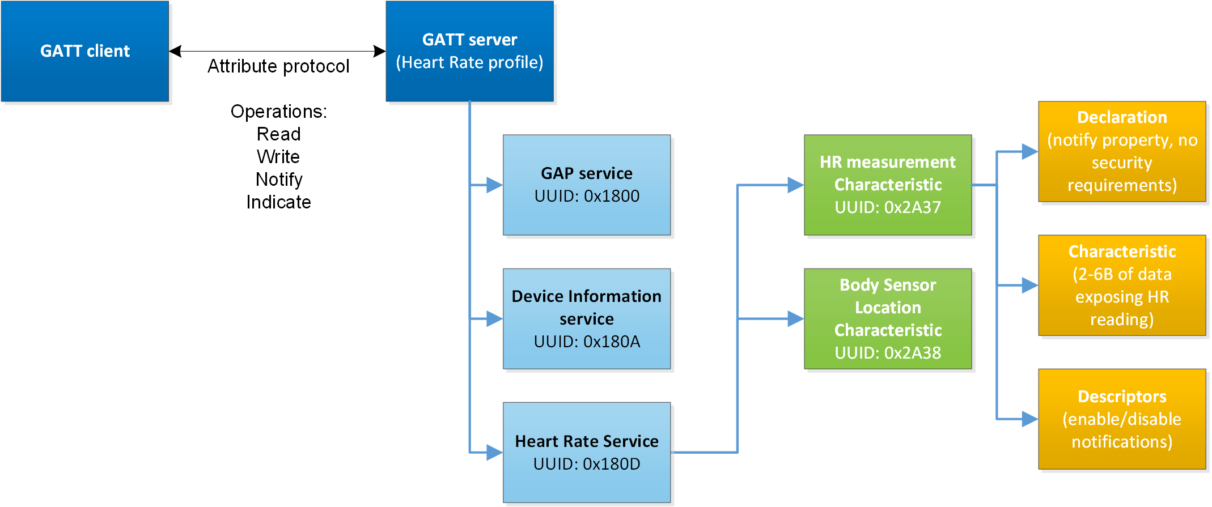
The GATT database
GATT : Generic ATTribute protocol
Data is organized and described with the GATT database
  Service – Describes a set of data like Health Thermometer
    Bluetooth SIG standardized services identified by unique 16-bit UUIDs
    Vendor specifc services identified by 128-bit UUIDs
    Services contain one or more characteristics
  Characteristic – Describes data within a service
    Describe data like Temperature Measurement
    Standardized characteristics identified by unique 16-bit UUIDs
    Vendor specific characteristics identified by 128-bit UUIDs
  Characteristic properties (Declaration)
    Tell which operations can be used to access the data
    (Read, Write, Notify etc.)
    Tell which security means must be used to access the data
    (bonding, encryption etc.)
Notes:
The GATT protocol gives meaning to the attributes. It defines a GATT database. The attributes (of the ATT layer) are used both to describe the structure of this database and to hold the data of the database.
Therefore we differentiate Declaration, Descriptor and Characteristic attributes:
-Declarations describe the structure of the database
-Descriptors describe the format and the status of the database entries
-Characteristics contain the data of the database entries
The database structure has 3 levels:
-Characteristics hold the data entries
-Characteristics are grouped into Services to differentiate data groups. E.g. one data groups is used to describe the device (name, firmware etc.), and another group is used to describe the sensor status (temperature, etc.)
-Services are grouped into Profiles. One device implements one Profile. If the device implements a predefined (standard) Profile, then other devices know the service/characteristic structure under it from the standard and they do not have to discover it. This is designed for interoperability.
We differentiate standard and custom services/characteristics
-the format of standard services/characteristics are strictly defined by the Bluetooth SIG. These services/characteristics are identified with 16bit UUID. Hence, the UUID is a unique reference to a specific service/characteristic format. The standard UUIDs are listed here: https://www.bluetooth.com/specifications/gatt/services
-custome formats can be implemented as well. For this case a 128bit UUID has to be generated. See e.g. https://www.uuidgenerator.net/

Slide 24
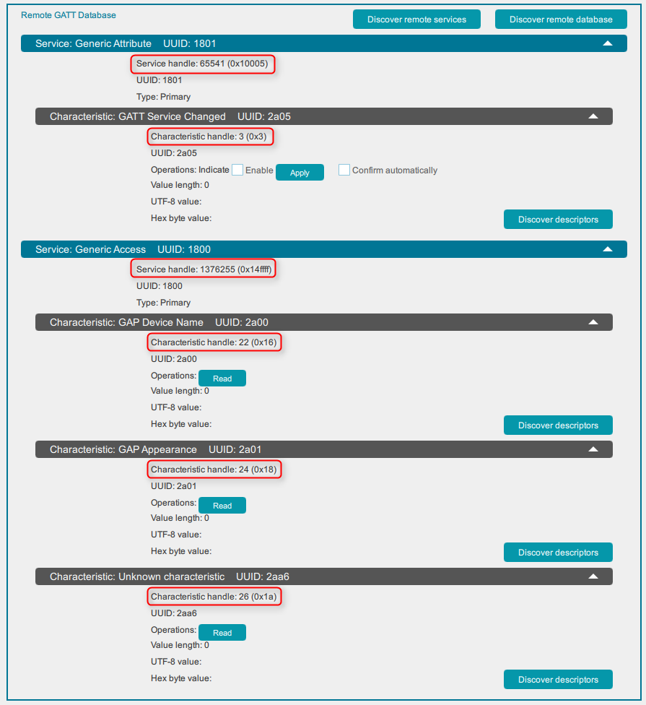
Service Discovery
UUID defines only the type/format of the service/characteristic/descriptor
There can be multiple service/characteristic/descriptor with the same UUID
To refer to a specific service/characteristic/descriptor handles are used
Handles have to be queried first from the server – Service Discovery
  Discover service handles
  Discover charateristic handles
  Discover descriptor handles
These handles can be used when reading/writing to the database
Notes:
The ATT protocol uses handles to read/write attributes. To obtain the handle of each characteristic attribute, the GATT database has to be discovered first. The GATT protocol defines GATT commands for this process.

Slide 25
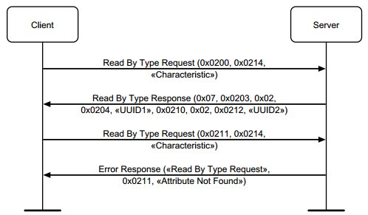
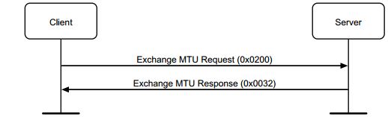
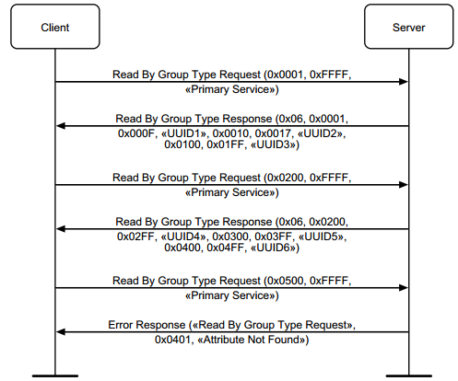
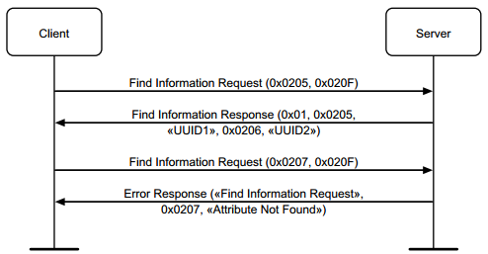
Service Discovery
  Server Configuration
    Exchange MTU
  Primary Service Discovery
Characteristic discovery
Characteristic descriptor discovery
Notes:
The ATT protocol uses handles to read/write attributes. To obtain the handle of each characteristic attribute, the GATT database has to be discovered first. The GATT protocol defines GATT commands for this process.

Slide 26
Attribute Protocol Methods
  Reading Attributes
    Read by Type Rq/Rsp
      Get attribute Value by Type (Handle not known)
      Result: List of Handle-Value pairs (ordered by Handle)
      Not found/Authentication Error -> Error Response
    Read Req/Rsp
      Regular Read by Handle
      Mandatory
OpCode = 0x08 (1B) | Starting Handle (2B) | Ending Handle (2B) | Attribute Type (2B/16B)
OpCode = 0x09 (1B) | Length (2B) | Attribute Data List (2..ATT_MTU-2 B)
Handle (2B) | Value (Length-2 B)
Handle (2B) | Value (Length-2 B)
…
OpCode = 0x0A (1B) | Attribute Handle (2B)
OpCode = 0x0B (1B) | Attribute Value (0..ATT_MTU-1 B)
Notes:
Here we list the format of some ATT protocol packets to read/write data from/to the attributes of the server.

Slide 27
Attribute Protocol Methods
  Writing Attributes
    Write Req / Rsp
      Regular Write Value of an Attribute
    Write command
      Command -> No Acknowledgement / Error Response
    Signed write command
      Command -> No Acknowledgement / Error Response
      Authenticated Write over an anauthenticated Channel
OpCode = 0x12 (1B) | Attribute Handle (2B) | Attribute Value (0..ATT_MTU-3 B)
OpCode = 0x13 (1B)
OpCode = 0x52 (1B) | Attribute Handle (2B) | Attribute Value (0..ATT_MTU-3 B)
OpCode = 0xD2 (1B) | Attribute Handle (2B) | Attribute Value (0..ATT_MTU-15 B) | Attribute signature (12B)
Notes:
Here we list the format of some ATT protocol packets to read/write data from/to the attributes of the server.

Slide 28
Attribute Protocol Methods
Server initiated Methods
  Handle Value Notification
    No Acknowledgement / Error Response
  Handle Value Indication
    Needs Handle Value Confirmation
Client
Server
OpCode = 0x1B (1B) | Attribute Handle (2B) | Attribute Value (0..ATT_MTU-3 B)
Notification
Notification
Notification
Indication
Confirmation
OpCode = 0x1D (1B) | Attribute Handle (2B) | Attribute Value (0..ATT_MTU-3 B)
Indication
Confirmation
OpCode = 0x1E (1B)
Notes:
Here we list the format of some ATT protocol packets to read/write data from/to the attributes of the server.

Slide 29
Packet Structure (of a write request)
This is a simplified example, where we force the write request to be transmitted in one LL packet.
The write request could be longer and be segmented into more LL packets
Preamble (1B) | Access Address (4B) | PDU (2..257B) | CRC (3B)
Link Layer
LL Header (2B) | Payload (0..251B) | MIC (4B)
L2CAP
Length (2B) | Channel ID (2B) | Payload (0..247B)
GATT
OpCode = 0x12 (1B) | Attribute Handle (2B) | Attribute Value (0..244B)
Notes:
To summarize the full packet structure, here all are the expanded view of an ATT write packet, ordered into layers.
This is the case when the data to be written is not more than 244B. In this case the whole ATT command fits into one Link Layer packet, and no segmentation is needed. If more data is sent, then the L2CAP packet will be segmented and sent in more than one Link Layer packets.

Slide 30
Bluetooth Security
SMP – security Management Protocol
Profiles
GAP
GATT
SMP
ATT
L2CAP
Link Layer
Physical Layer

Slide 31
Bluetooth Security
The most common threats in wireless communications are:
  Passive eavesdropping
  Man-in-the-Middle (MITM) protection
  Privacy
Bluetooth provides three basic security services:
  Authentication and authorization: Establishing trusted relationships between devices
  Encryption and data protection: Protecting data integrity and confidentiality
  Privacy and confidentiality: Preventing device tracking
The Bluetooth security model includes five security features:
  Pairing: the process for creating shared secret keys
  Bonding: storing the keys created during pairing so they can be used later
  Device authentication: verification of stored keys
  Encryption: data confidentiality
  Message integrity: protection against data alteration
All security algorithms or mechanisms used in Bluetooth are either FIPS or NIST approved
Notes:
Bluetooth standard provides 3 security services:
-encryption means that the packets are encrypted with security keys, hence they cannot be eavesdropped. (Bluetooth uses AES-128 as the encryption algorithm)
-authentication means, that security keys are also exchanged securely, hence packets cannot be decoded, modified and re-encoded by a third party.
-privacy means, that the devices can use random addresses instead of a static public address, to avoid device tracking. The random address can be resolved with security keys to get the real identity of the device

Slide 32
Pairing & Bonding
Pairing
  Is the process of creating trusted relationships between devices
  Used to generate and exchange security keys (Bluetooth uses AES-128 as the encryption algorithm)
  Used to exchange identity information
Bluetooth uses Secure Simple Pairing (SSP) pairing model
  Just works For devices without UI. No user interaction required. No MITM protection.
  Passkey entry User needs to enter a passkey the remote party displays. Provides MITM protection.
  Numeric comparison User needs to confirm passkeys both devices display. Provides MITM protection.
  Out-of-band Encryption keys exchanged f.ex. using NFC
Bonding
  Storing of security keys for future use
  f.ex. authentication of connections or verifying devices identity
Notes:
In order to secure the connection, the devices have to exchange security keys. This is called pairing.
This can be done automatically, but automatic key exchange does not ensure, that the keys cannot be obtained by a third party, i.e. it does not provide autchentication.
To make the key exchange more secure, a passkey has to be exchanged via another channel. Typically one device displays a passkey, that a user has to input on the other device, but different scenarios exist.
The secure key exchange has to be done only once. They can be stored on the devices. So if the devices got disconnected and reconnected, they can use their stored keys to secure their new connection. This is called bonding.

Slide 33
Pairing & Bonding
 |  | Initiator
 |  | DisplayOnly | DisplayYesNo | KeyboardOnly | NoInputNoOutput | KeyboardDisplay
Responder | DisplayOnly | Just Works | Just Works | Passkey Entry (R displays, I inputs) | Just Works | Passkey Entry (R displays, I inputs)
 | DisplayYesNo | Just Works | Numeric Comparision | Passkey Entry (R displays, I inputs) | Just Works | Numeric Comparision
 | KeyboardOnly | Passkey Entry (I displays, R inputs) | Passkey Entry (I displays, R inputs) | Passkey Entry (R and I inputs) | Just Works | Passkey Entry (I displays, R inputs)
 | NoInputNoOutput | Just Works | Just Works | Just Works | Just Works | Just Works
 | KeyboardDisplay | Passkey Entry (I displays, R inputs) | Numeric Comparision | Passkey Entry (R displays, I inputs) | Just Works | Numeric Comparision
Notes:
Different pairing methods can be used based on the input/output capabilities of the devices. See table.

Slide 34
Privacy
14:25:36:47:58:69
13:24:35:46:57:68
12:34:56:12:34:56
Bluetooth provides privacy protection
Devices can either use public or private (random) addresses
  Public address is fixed and unique to a device
  Random address can change over time and hides the public address from unwanted devices
Bonded devices can resolve the public address
Random address
11:22:33:44:55:66
11:22:33:44:55:66
11:22:33:44:55:66
resolve
resolve
resolve
Public address
Notes:
If a device advertises itself alwas with the same static Bluetooth address, it can be tracked easily. This is often harmful.
To overcome this issue, random addresses can also be used. The random address is generated from the static address using a security key. Only bonded (trusted) devices know the security key with which the original address can be resolved.
The random number can change over time so it cannot be tracked. However, the trusted devices know that the different random addresses belong to the same device.

Slide 35
Encryption
Encryption protects the data confidentiality and integrity
Paired or bonded devices can encrypt/decrypt data sent within a connection
Bluetooth uses AES-128 as the encryption algorithm
Notice: No encryption of broadcast data

Slide 36
Thank you

